Slide 1

Visual Question-Answering
Team Members:
Abdalla Shaaban Elsayed
Rabah Jamal Mohammed Ali
Abdullah Abdelkader Roshdy
Abdullah Mahmoud Abdullah
Supervisor:
Dr\ Sally Saad
TA\ Ahmed Salah
1

Slide 2
Outline
Introduction
Motivation
Problem definition
Objective
Working Phases
Time Plan
Tools
References
2

Slide 3
Outline
Introduction
3

Slide 4
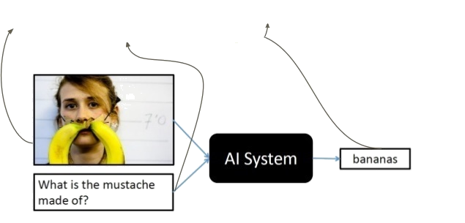
Introduction​
Question-Answering
Visual
Predict the Answer of a given question related to an image.
5

Slide 5
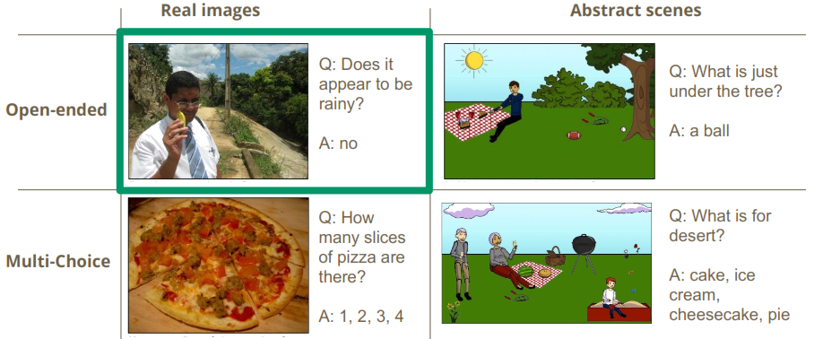
Types of Visual Question-Answering
6

Slide 6
Outline
Introduction
Motivation
7

Slide 7
Motivation
Performing complex activities.
Merging between two or more sub-problems.
Understanding:
- Convolutional neural network
- Natural language processing
- Recurrent neural network
Obtaining high accuracy from complex model.
8

Slide 8
Applications
Blind helper is an application that allows blind users to receive quick answers to questions about their surroundings.
Visual chatbot a chatbot that capable of answering a sequence of questions about images.
9

Slide 9
Outline
Introduction
Motivation
Problem definition
10

Slide 10
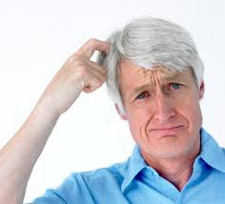
Problem definition
How to build a model that extract feature of an image related
to a given question ?
11

Slide 11
Outline
Introduction
Motivation
Problem definition
Objective
12

Slide 12
Objectives
Build a visual question answering system by taking a question and an image as input and outputs a response to the answer .
We aim to slightly improve the result using hierarchical co-Attention (mechanism that jointly reasons about visual attention and question attention) technique.
13

Slide 13
Outline
Introduction
Motivation
Problem definition
Objective
Working Phases
14

Slide 14
Phases Diagram
Data Preprocessing
Model Building
Model Testing and Validation
Model Interface
15

Slide 15
Phases overview | Data preprocessing
Gathering Datasets
VQA Dataset
COCO-QA Dataset
16

Slide 16
Phases overview | Data preprocessing
Preparing Dataset
Cleaning the dataset using NLTK.
Text representation using word embedding.
16

Slide 17
Phases overview | Model Building
Question
Word Embedding
Question Hierarchy
Co-Attention
Encoding for Predicting Answers
Image
CNN
Image Feature
16

Slide 18
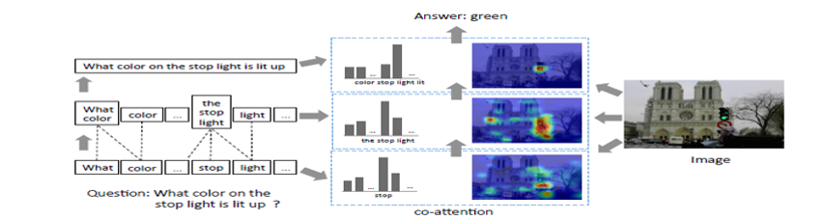
Phases overview | Model Building
Model over view

Slide 19
Phases overview | Model Building
Model over view
Words Level

Slide 20
Phases overview | Model Building
Model over view
Words Level
Phrases Level

Slide 21
Phases overview | Model Building
Model over view
Words Level
Phrases Level
Question Level

Slide 22
Phases overview | Model Building
Question
Image
16

Slide 23
Phases overview | Model Building
Question
Image
CNN
Image Feature
16

Slide 24
Phases overview | Model Building
Features Extraction of the image.
rescale the image to 448 X 448
We input the image to ResNet.
We take the activation from the last pooling layer of ResNet as its feature

Slide 25
Phases overview | Model Building
Features Extraction of the image.
ResNet CNN Hierarchy

Slide 26
Phases overview | Model Building
Question
Word Embedding
Question Hierarchy
Image
CNN
Image Feature
16

Slide 27
Phases overview | Model Building
Given the 1-hot encoding of the question words Q = {q1,……, qT}
Embed the words to a vector space to get Q^{w} = {q^{w}₁ ,……, q^{w}_{t}}

Slide 28
Phases overview | Model Testing
Measuring the system’s accuracy and the level of correctness of the predicted answers.
Enhancing the accuracy by experimenting different types of convolutional neural network to extract the image features
21

Slide 29
Phases overview | Interface
Build a user interface for the system, which allows the user to interact with the system.
Using Python’s framework with CSS and Javascript (optional).
22

Slide 30
Outline
Introduction
Motivation
Problem definition
Objective
Working Phases
Time Plan
23

Slide 31
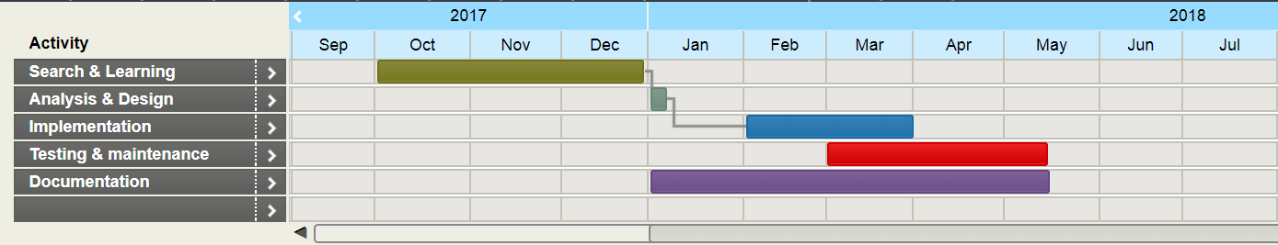
Time Plan
24

Slide 32
Outline
Introduction
Motivation
Problem definition
Objective
Working Phases
Time Plan
Tools
25

Slide 33
Tools
Languages:
Python for preprocessing the datasets.
Javascript for the UI (optional).
Libraries and Frameworks:
NLTK, Pillow (Python Imaging Library) for preprocessing the dataset.
TensorFlow to build the model.
26

Slide 34
Outline
Introduction
Motivation
Problem definition
Objective
Working Phases
Time Plan
Tools
References
27

Slide 35
References
Chenyue Meng and Yixin Wang, “Image-Question-Linguistic Co-Attention for Visual Question Answering”, 2016.
Alisha Rege and Payal Bajaj C, “From Vision to NLP: A Merge”, 2017.
Ronghang Hu and Jacob Andreas and Marcus Rohrbach, “Learning to Reason: End-to-End Module Networks for Visual Question Answering” , 2017.
Jiasen Luand Jianwei Yang and Dhruv Batra , “Hierarchical Question-Image Co-Attention for Visual Question Answering” , 2017
28

Slide 36
Questions
29

Slide 37
Thank You!
30

